Slide 1

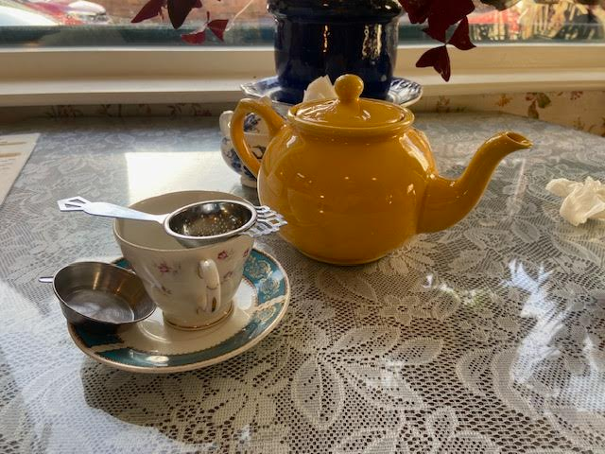
Wee Social Tea, Beyond Assam
By Anthony McKale Associate Director of DevOps and Cloud
Date 02-2024

Slide 2

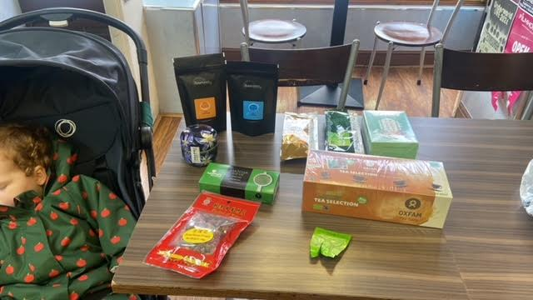
TABLE OF CONTENTS - INTRO TO TEA - TEA TASTING NOTES
- TEA + CHAT
- TEA TASTING COMPETITION

Slide 3
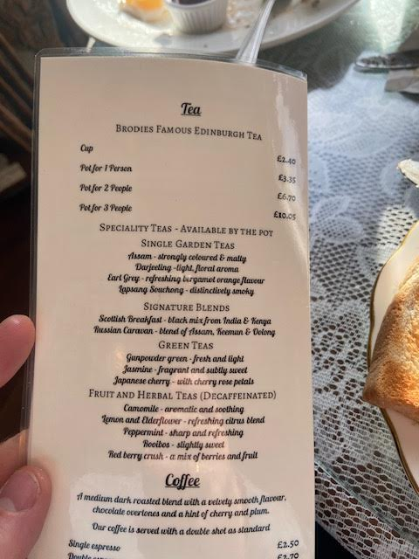
Intro to TEA

Slide 4
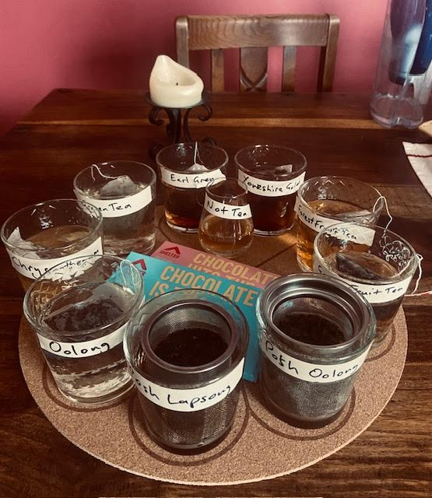
INTRO
9 Teas to Taste 4 Teas to identify
Covering Black Tea, Green Tea, and lastly Fruit Tea Not Milky Tea

Slide 5
Tea Tasting Notes
From a opinionated Scotsman

Slide 6
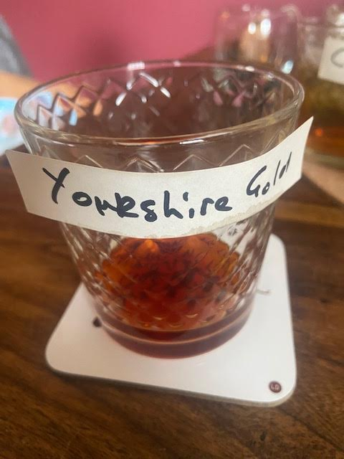
Yorkshire Gold
Colour: Cola Black/Brown Nose: Faint Burnt Sugar (very faint) Taste: Water / Faint Burnt Wood / Faint Herb (Sage)

Slide 7
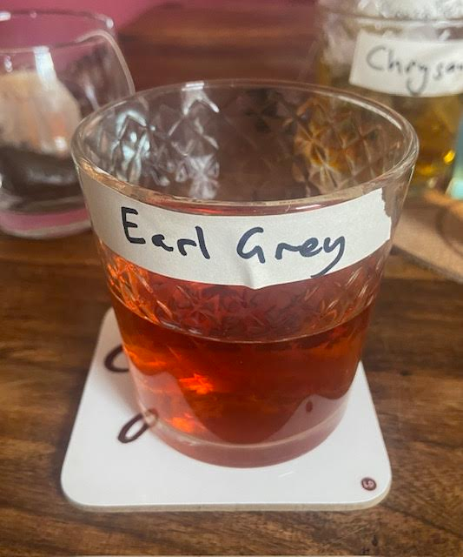
Earl Grey
Colour: Amber Gold Nose: Honey / Fresh Grass Taste: Mild Detergent
Sea Salt
Burnt Oak

Slide 8
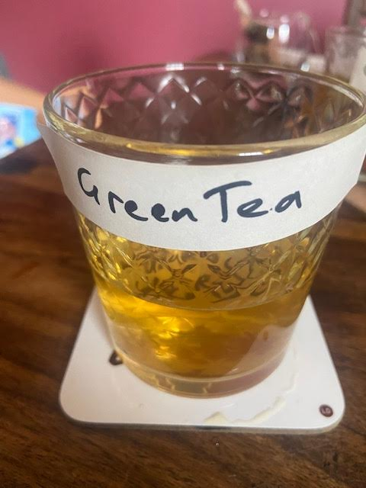
Green Tea
Colour: Apple Juice Yellow Nose: Meadow Breeze Taste: Lemon / Soft Mint / Herby

Slide 9
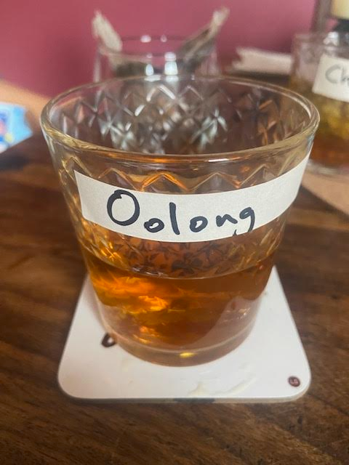
Oolong Tea
Colour: Irn Bru Orange Nose: Faint Sickly Sweet
Taste: Strong Woody Flavour / Herb (Rosemary) / Faint Burnt Summer Fruit

Slide 10
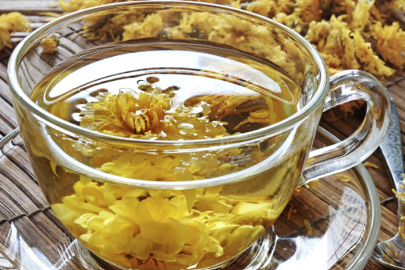
Chrysanthemum Tea
Colour: Irn Bru Orange Nose: Orange Peel
Taste: Orange / Bamboo Flesh / Faint Sickly Sugary Sweetness

Slide 11
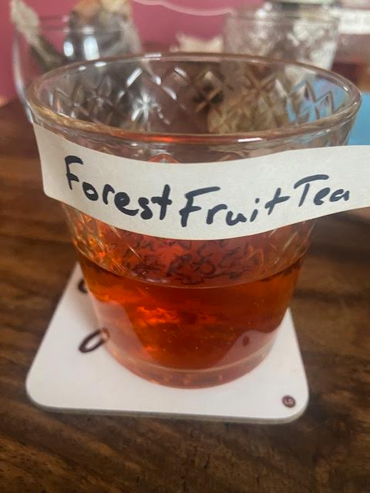
Forest Fruit Tea
Colour: Cola Kube Red Nose: Sweetie Sugar Smell
Taste: Burnt Wood / Strawberry / Strong Herb (Sage) (Actually Redbush ?)

Slide 12
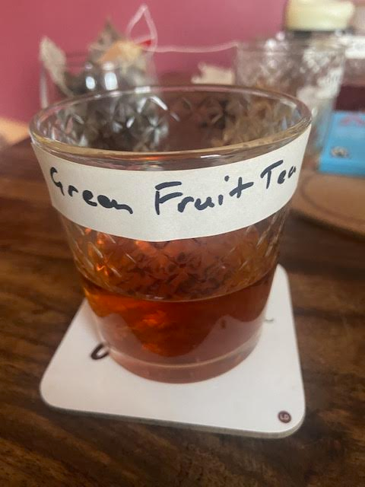
Green Peach Tea
Colour: Burnt Amber Nose: Wood / Moss
Taste: Strong Moss / Sickly sweet after taste / Faint Peach notes

Slide 13
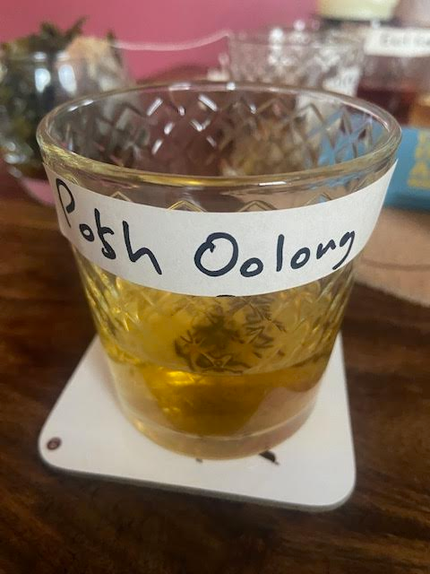
Posh Milky Oolong
Colour: Light Honey / Greenish Nose: Honey, Off-Flavour/Smelling
Taste: Ice cream / Vanilla / Herb (light)

Slide 14
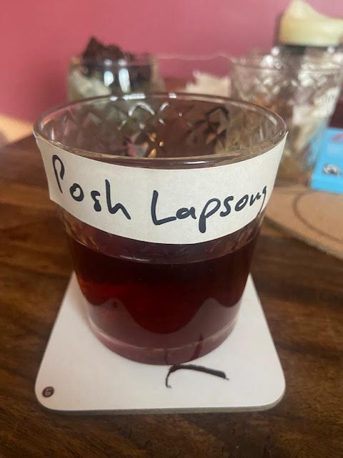
Posh Lapsang
Colour: Dark Ale Nose: Peaty (Strong)
Taste: Charred Peat Soil / Sweet Amber / Orange Peel

Slide 15
Tea Competition

Slide 16
Tea Competition
Audience participation Question: What are the families of the 4 mystery teas ? Options: English Breakfast / Yorkshire Gold Earl Grey Lapsang
Oolong
Green Tea Chrysanthemum Tea Fruit Tea

Slide 17
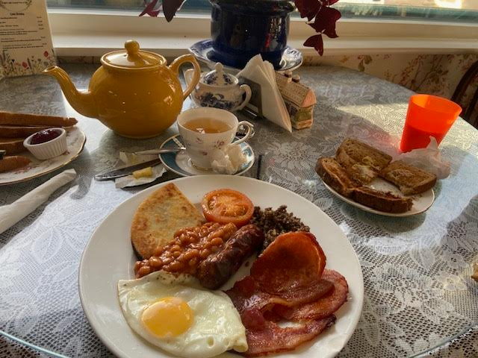

Questions?

Slide 18
Thank you for your Awesomeness
If you have any questions anthony.mckale@6point6.co.uk #dep-eng-devops (slack)

